Slide 1
The Photo Challenge
Photoshop 2012-2013

Slide 2
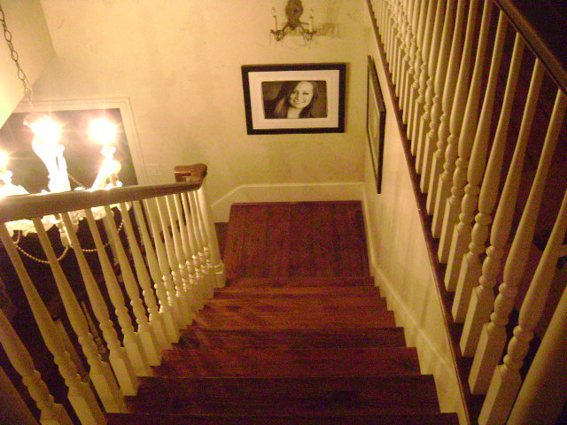
Birds’ Eye View

Slide 3
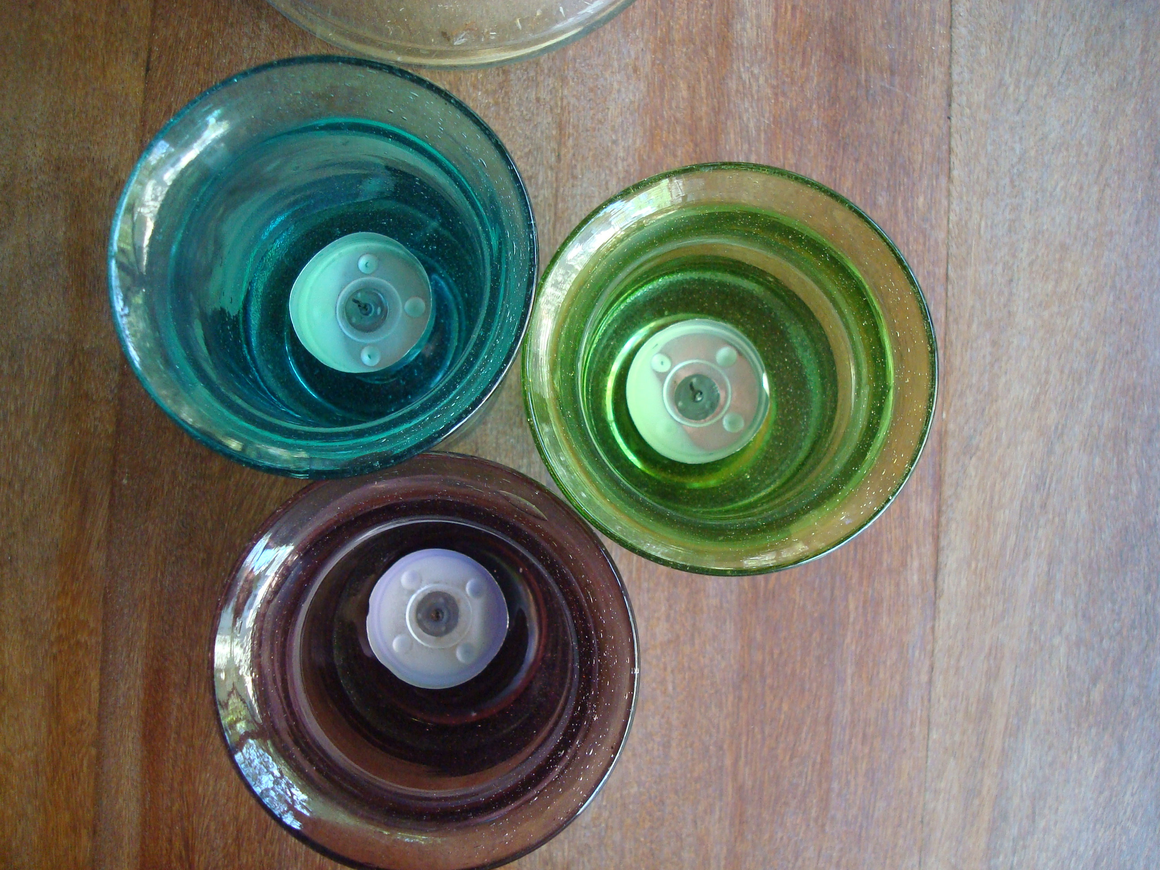

Slide 4
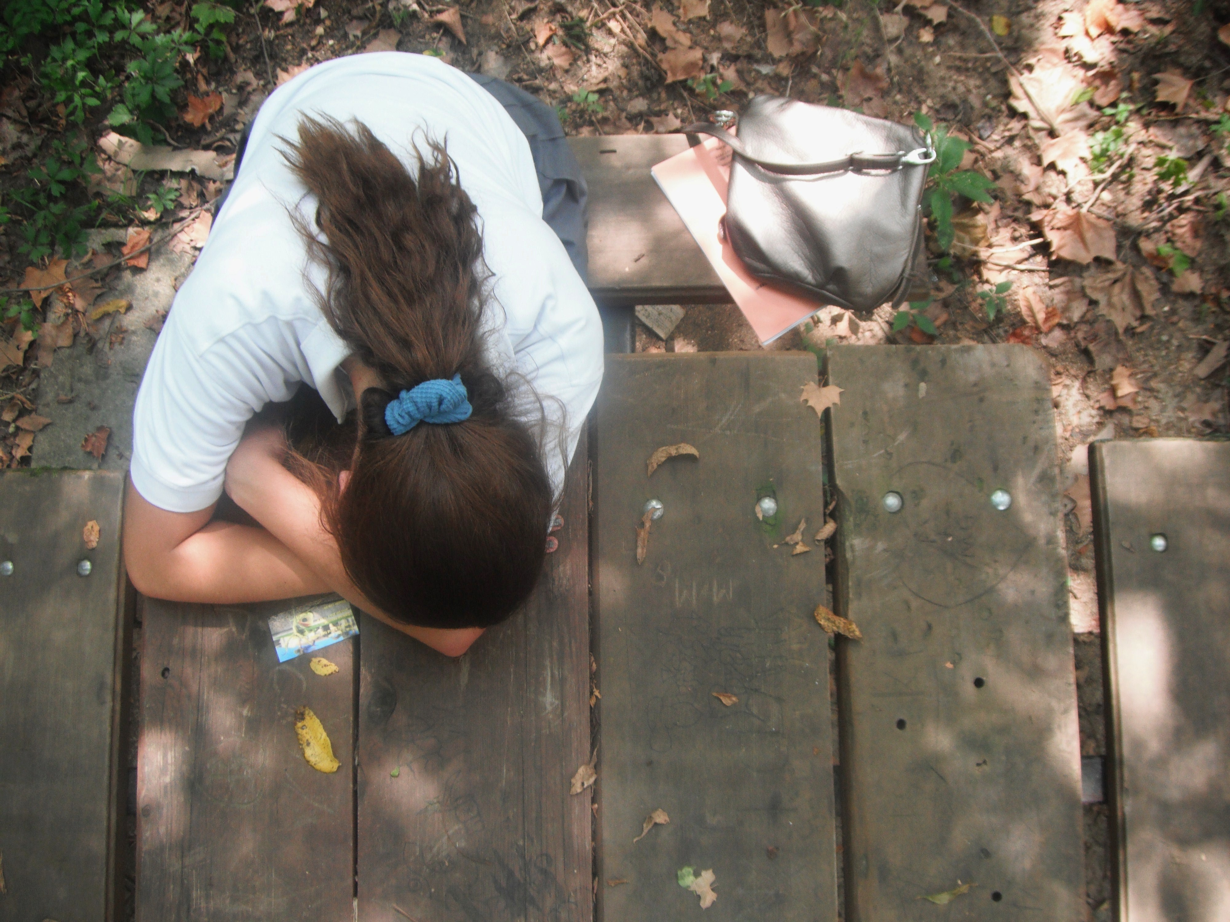

Slide 5
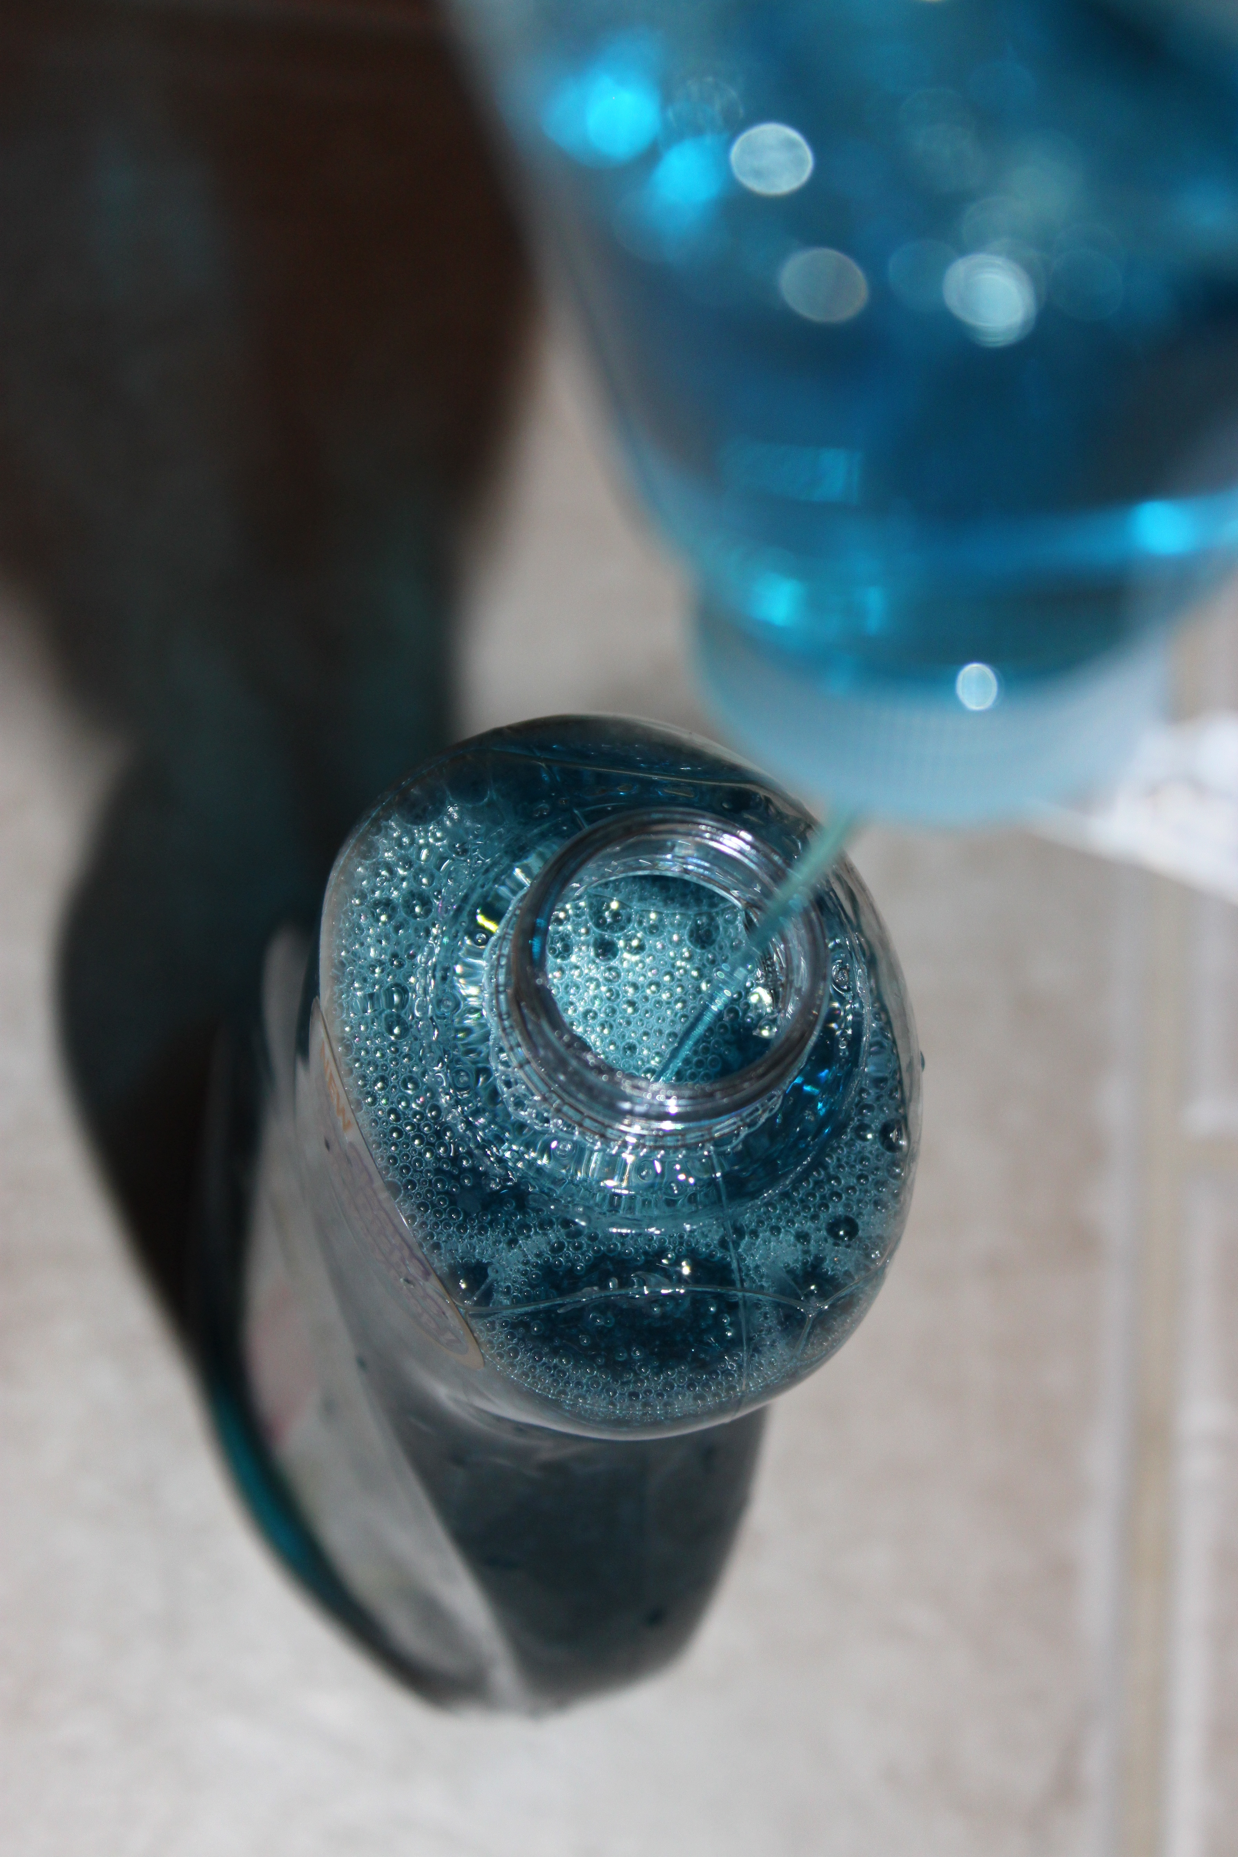

Slide 6
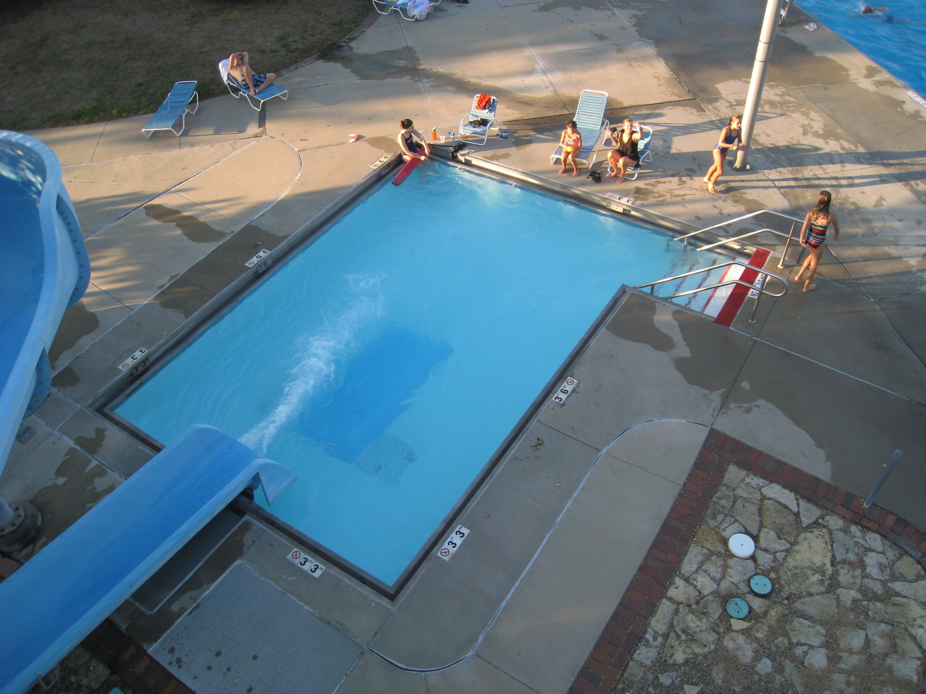

Slide 7
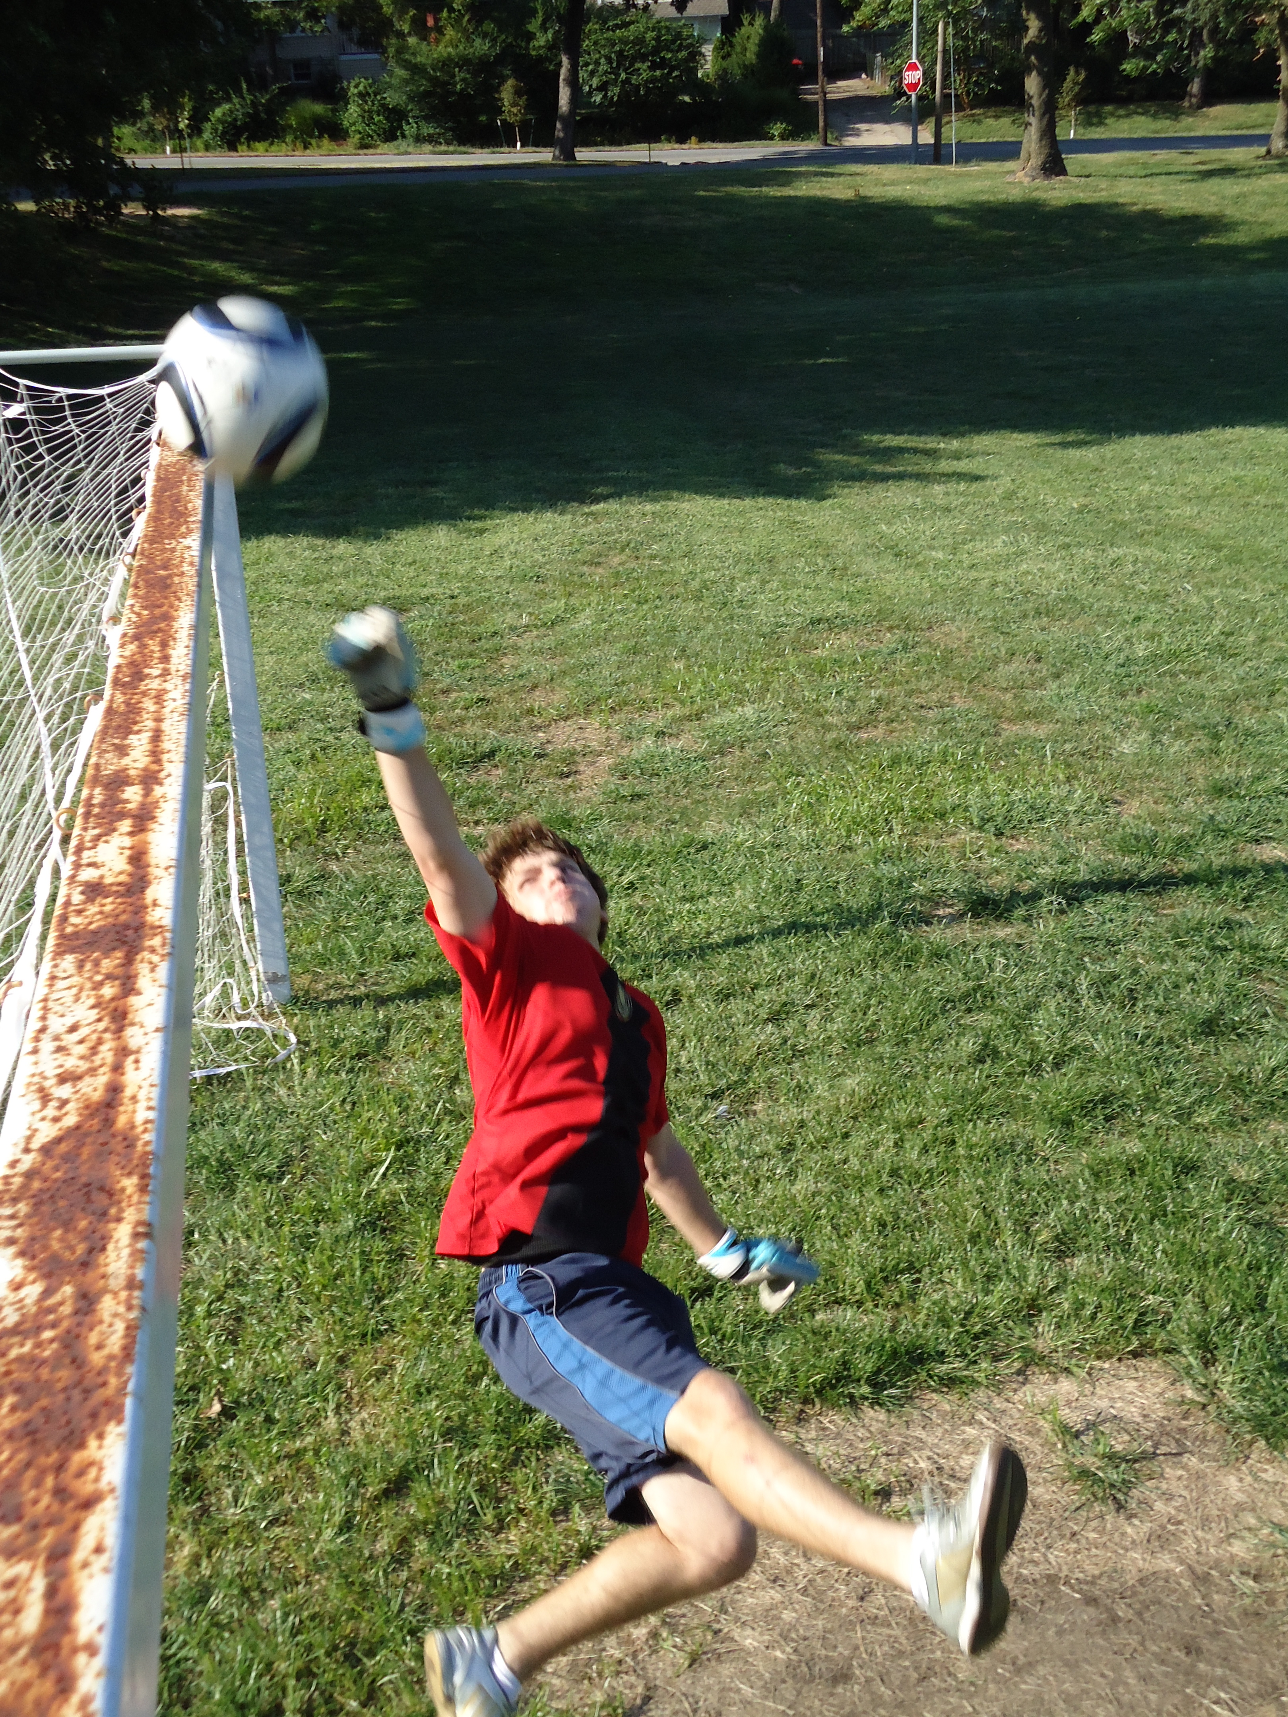

Slide 8
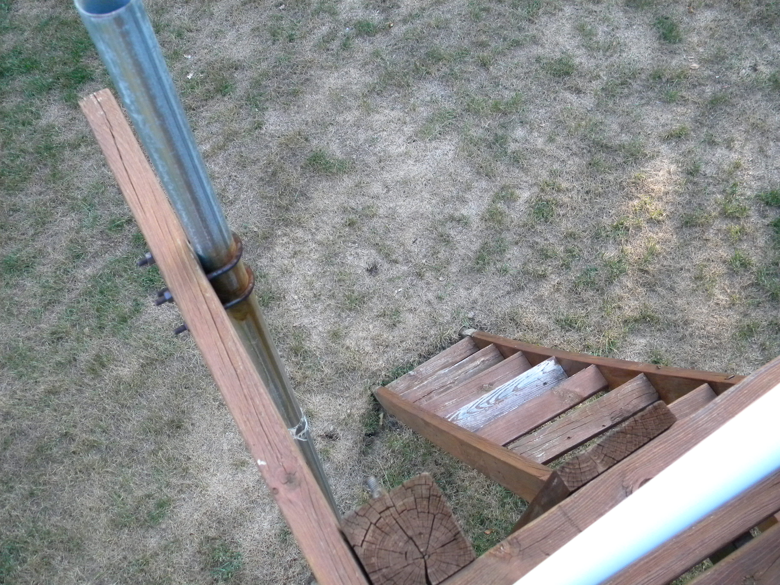

Slide 9
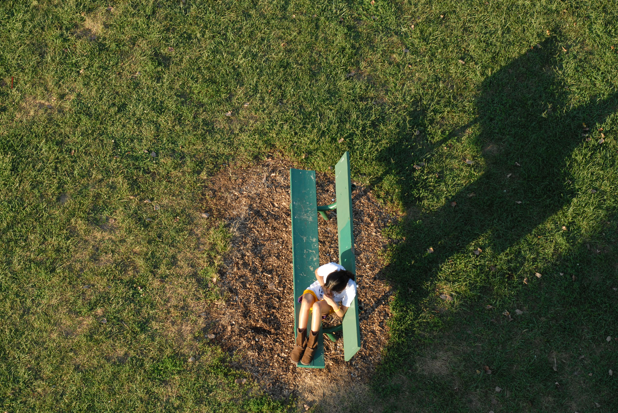

Slide 10
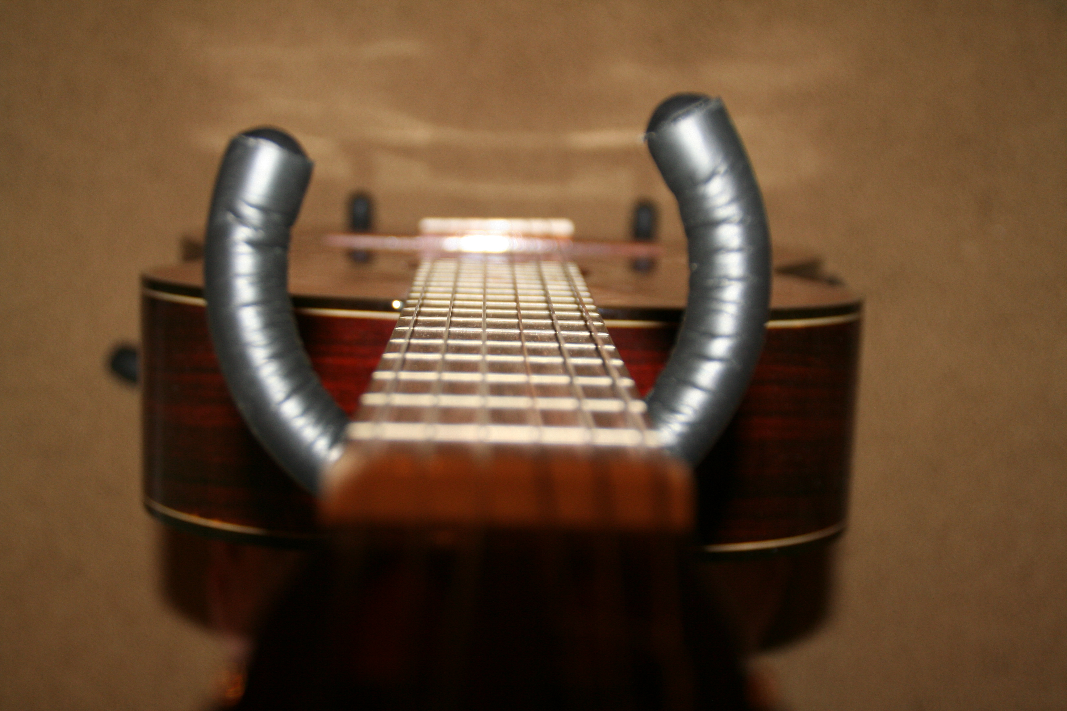

Slide 11
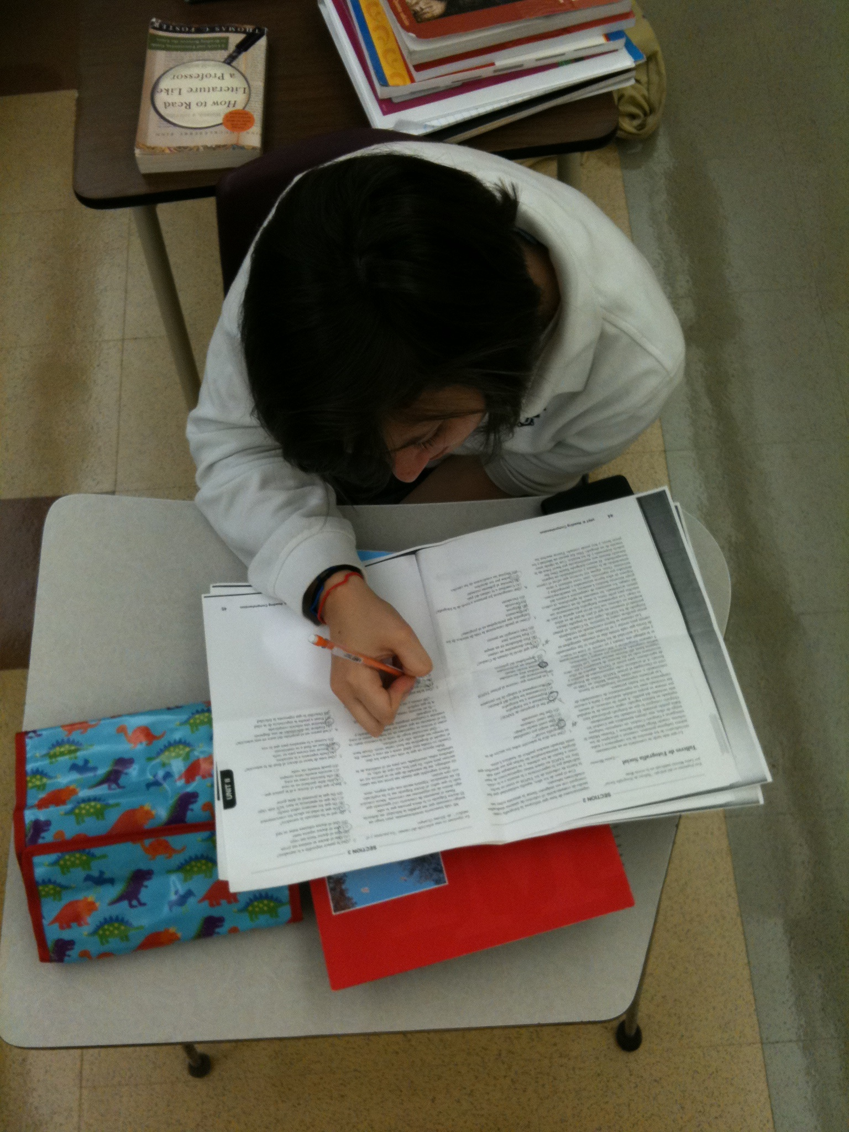

Slide 12
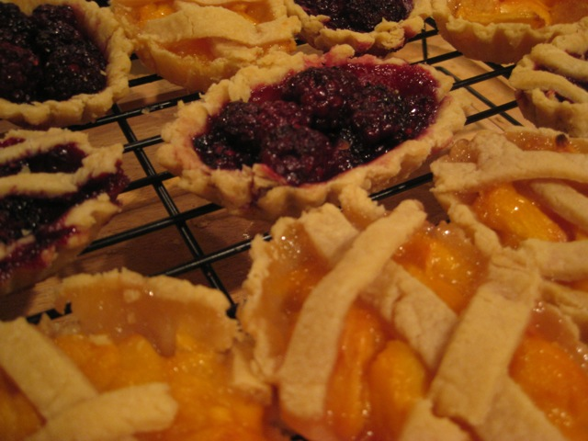

Slide 13


Slide 14
Assignment #1
Take and download 10 Bird’s eye Pictures
Place them in a folder titled: BirdsEye_Student Name
Drag your folder into the Digital Photo Share
Due January 7, 2013
Worth 50 points

